Slide 1
Internet of Things VII Sem Dept of CSE, NIT Raipur Unit II IoT Protocols IoT Access Technologies Topic 6LoWPAN, 6Lo
Dr. Veena Anand

Slide 2
6LoWPAN
6LoWPAN is an IPv6 protocol, and It’s extended from is IPv6 over Low Power Personal Area Network.
As the name itself explains the meaning of this protocol is that this protocol works on Wireless Personal Area Network i.e., WPAN.
WPAN is a Personal Area Network (PAN) where the interconnected devices are centered around a person’s workspace and connected through a wireless medium.
6LoWPAN allows communication using the IPv6 protocol. IPv6 is Internet Protocol Version 6 is a network layer protocol that allows communication to take place over the network.

Slide 3
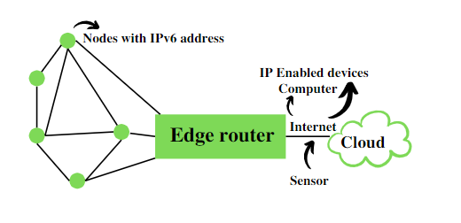
6LoWPAN
It comprises an Edge Router and Sensor Nodes. Even the smallest of the IoT devices can now be part of the network, and the information can be transmitted to the outside world as well. For example, LED Streetlights.

Slide 4
6LoWPAN
It is a technology that makes the individual nodes IP enabled.
6LoWPAN can interact with 802.15.4 devices and also other types of devices on an IP Network. For example, Wi-Fi.
It uses AES 128 link layer security, which AES is a block cipher having key size of 128/192/256 bits and encrypts data in blocks of 128 bits each.
This is defined in IEEE 802.15.4 and provides link authentication and encryption.

Slide 5
6LoWPAN
Basic Requirements of 6LoWPAN:
The device should be having sleep mode in order to support the battery saving.
Minimal memory requirement.
Routing overhead should be lowered.
Features of 6LoWPAN:
It is used with IEEE 802.15,.4 in the 2.4 GHz band.
Outdoor range: ~200 m (maximum)
Data rate: 200kbps (maximum)
Maximum number of nodes: ~100

Slide 6
6LoWPAN
Advantages of 6LoWPAN:
6LoWPAN is a mesh network that is robust, scalable, and can heal on its own.
It delivers low-cost and secure communication in IoT devices.
It uses IPv6 protocol and so it can be directly routed to cloud platforms.
It offers one-to-many and many-to-one routing.
In the network, leaf nodes can be in sleep mode for a longer duration of time.

Slide 7
6LoWPAN
Disadvantages of 6LoWPAN:
It is comparatively less secure than Zigbee.
It has lesser immunity to interference than that Wi-Fi and Bluetooth.
Without the mesh topology, it supports a short range.
Applications of 6LoWPAN:
It is a wireless sensor network.
It is used in home-automation,
It is used in smart agricultural techniques, and industrial monitoring.

Slide 8
6LoWPAN
Security and Interoperability with 6LoWPAN:
Security:
6LoWPAN security is ensured by the AES algorithm, which is a link layer security, and the transport layer security mechanisms are included as well.
Interoperability:
6LoWPAN is able to operate with other wireless devices as well which makes it interoperable in a network.

Slide 9
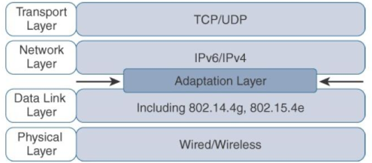
6LoWPAN
While the Internet Protocol is key for a successful Internet of Things, constrained nodes and constrained networks mandate optimization at various layers and on multiple protocols of the IP architecture.
Some optimizations are already available from the market or under development by the IETF. The following figure highlights the TCP/IP layers where optimization is applied.

Slide 10
6LoWPAN
In the IP architecture, the transport of IP packets over any given Layer 1 (PHY) and Layer 2 (MAC) protocol must be defined and documented.
The model for packaging IP into lower-layer protocols is often referred to as an adaptation layer.
Unless the technology is proprietary, IP adaptation layers are typically defined by an IETF working group and released as a Request for Comments (RFC).
An RFC is a publication from the IETF that officially documents Internet standards, specifications, protocols, procedures, and events.

Slide 11
6LoWPAN
For example, RFC 864 describes how an IPv4 packet gets encapsulated over an Ethernet frame, and RFC 2464 describes how the same function is performed for an IPv6 packet.
IoT-related protocols follow a similar process. The main difference is that an adaptation layer designed for IoT may include some optimizations to deal with constrained nodes and networks.
The main examples of adaptation layers optimized for constrained nodes or “things” are the ones under the 6LoWPAN working group and its successor, the 6Lo working group.

Slide 12
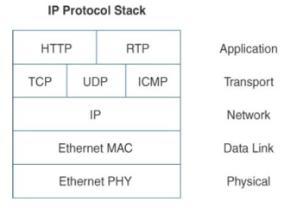
6LoWPAN
The initial focus of the 6LoWPAN working group was to optimize the transmission of IPv6 packets over constrained networks such as IEEE 802.15.4.
The following Fig. shows an example of an IoT protocol stack.

Slide 13
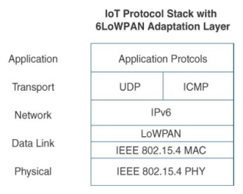
6LoWPAN
The following Fig. shows an example of an IoT protocol stack using the 6LoWPAN adaptation layer.

Slide 14
6LoWPAN
The 6LoWPAN working group published several RFCs, but RFC 4994 is foundational because it defines frame headers for the capabilities of header compression, fragmentation, and mesh addressing.
These headers can be stacked in the adaptation layer to keep these concepts separate while enforcing a structured method for expressing each capability.
Depending on the implementation, all, none, or any combination of these capabilities and their corresponding headers can be enabled.

Slide 15
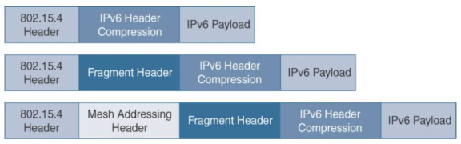
6LoWPAN: header stack
The following Fig. shows some examples of typical 6LoWPAN header stacks.

Slide 16
6LoWPAN: header compression
IPv6 header compression for 6LoWPAN was defined initially in RFC 4944 and subsequently updated by RFC 6282.
This capability shrinks the size of IPv6’s 40-byte headers and User Datagram Protocol’s (UDP’s) 8-byte headers down as low as 6 bytes combined in some cases.
Note that header compression for 6LoWPAN is only defined for an IPv6 header and not IPv4.
The 6LoWPAN protocol does not support IPv4, and, in fact, there is no standardized IPv4 adaptation layer for IEEE 802.15.4.

Slide 17
6LoWPAN: header compression
6LoWPAN header compression is stateless, and conceptually it is not too complicated.
However, a number of factors affect the amount of compression, such as implementation of RFC 4944 versus RFC 6922, whether UDP is included, and various IPv6 addressing scenarios.
At a high level, 6LoWPAN works by taking advantage of shared information known by all nodes from their participation in the local network.
In addition, it omits some standard header fields by assuming commonly used values.

Slide 18
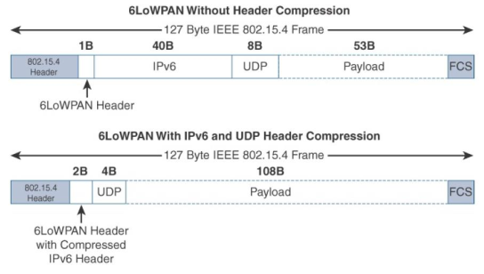
6LoWPAN: header compression
The following Figure highlights an example that shows the amount of reduction that is possible with 6LoWPAN header compression.

Slide 19
6LoWPAN: header compression
At the top of previous Figure, you see a 6LoWPAN frame without any header compression enabled:
The full 40- byte IPv6 header and 8-byte UDP header are visible.
The 6LoWPAN header is only a single byte in this case.
Notice that uncompressed IPv6 and UDPheaders leave only 53 bytes of data payload out of the 127- byte maximum frame size in the case of IEEE 802.15.4.

Slide 20
6LoWPAN: header compression
The bottom half of previous shows a frame where header compression has been enabled for a best-case scenario.
The 6LoWPAN header increases to 2 bytes to accommodate the compressed IPv6 header, and UDP has been reduced in half, to 4 bytes from 8.
Most importantly, the header compression has allowed the payload to more than double, from 53 bytes to 108 bytes, which is obviously much more efficient.
Note that the 2- byte header compression applies to intra-cell communications, while communications external to the cell may require some field of the header to not be compressed.

Slide 21
6LoWPAN: Fragmentation
The maximum transmission unit (MTU) for an IPv6 network must be at least 1280 bytes.
The term MTU defines the size of the largest protocol data unit that can be passed.
For IEEE 802.15.4, 127 bytes is the MTU.
This is a problem because IPv6, with a much larger MTU, is carried inside the 802.15.4 frame with a much smaller one.
To remedy this situation, large IPv6 packets must be fragmented across multiple 802.15.4 frames at Layer 2.

Slide 22
6LoWPAN: Fragmentation
The fragment header utilized by 6LoWPAN is composed of three primary fields:
Datagram Size, Datagram Tag, and Datagram Offset.
The 1-byte Datagram Size field specifies the total size of the unfragmented payload.
Datagram Tag identifies the set of fragments for a payload.
Finally, the Datagram Offset field delineates how far into a payload a particular fragment occurs. Figure 2.16 provides an overview of a 6LoWPAN fragmentation header.

Slide 23
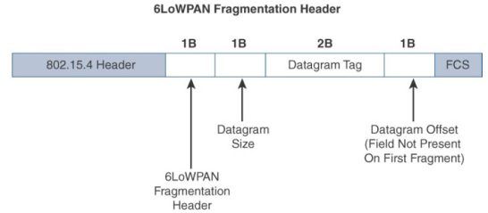
6LoWPAN: Fragmentation
The following figure provides an overview of a 6LoWPAN fragmentation header.

Slide 24
6LoWPAN: Fragmentation
In the previous figure, the 6LoWPAN fragmentation header field itself uses a unique bit value to identify that the subsequent fields behind it are fragment fields as opposed to another capability, such as header compression.
Also, in the first fragment, the Datagram Offset field is not present because it would simply be set to 0.
This results in the first fragmentation header for an IPv6 payload being only 4 bytes long.
The remainder of the fragments have a 5-byte header field so that the appropriate offset can be specified.

Slide 25
6LoWPAN: Mesh Addressing
The purpose of the 6LoWPAN mesh addressing function is to forward packets over multiple hops.
Three fields are defined for this header: Hop Limit, Source Address, and Destination Address.
Analogous to the IPv6 hop limit field, the hop limit for mesh addressing also provides an upper limit on how many times the frame can be forwarded.
Each hop decrements this value by 1 as it is forwarded.
Once the value hits 0, it is dropped and no longer forwarded.

Slide 26
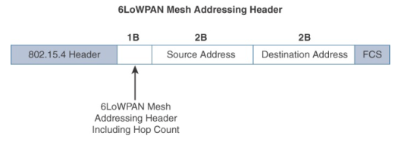
6LoWPAN: Mesh Addressing
The Source Address and Destination Address fields for mesh addressing are IEEE 802.15.4 addresses indicating the endpoints of an IP hop.
The following figure details the 6LoWPAN mesh addressing header fields.

Slide 27
6LoWPAN: Mesh Addressing
Note that the mesh addressing header is used in a single IP subnet and is a Layer 2 type of routing known as mesh-under.
RFC 4944 only provisions the function in this case as the definition of Layer 2 mesh routing specifications was outside the scope of the 6LoWPAN working group, and the IETF doesn’t define “Layer 2 routing.”
An implementation performing Layer 3 IP routing does not need to implement a mesh addressing header unless required by a given technology profile.

Slide 28
From 6LoWPAN to 6Lo
The 6lo (IPv6 over Networks of Resource-constrained Nodes) Working Group (WG) was formed in August 2013.
It was co-chaired by Ulrich Herberg and Samita Chakrabarti, under the leadership of Brian Haberman as Internet area director and Ralph Droms as technical advisor.
The Working Group is a successor of the 6LoWPAN WG, with a primary difference that 6lo defines specifications for running IPv6 over multiple constrained L2 technologies that use a base 6LoWPAN stack (RFC 4944, RFC 6282, RFC 6775) for the IPv6 low-power adaptation, stateless header compression and Neighbor.

Slide 29
From 6LoWPAN to 6Lo
6lo defines specifications for IPv6 over constrained node networks comprise of the following:
Limited power, memory, and processing resources
Hard upper bounds on state, code space, and processing cycles
Optimization of energy and network bandwidth usage
Lack of some Layer 2 services, such as complete device connectivity and broadcast/multicast

Slide 30
From 6LoWPAN to 6Lo
Since its formation, the 6lo WG has produced IPv6-over-BLUETOOTH Low Energy (RFC 7668) and IPv6-over-Zwave (RFC 7428), and has been working on:
Documents, including IPv6-over-DECT Ultra Low Energy,
IPv6-over-BACNET Master-Slave/Token-Passing networks,
IPv6-over-Near Field Communication,
extensions for LOWPAN dispatch functions,
New ethertype request document for assigning a new ethertype for LOWPAN encapsulated IPv6 datagrams.

Slide 31
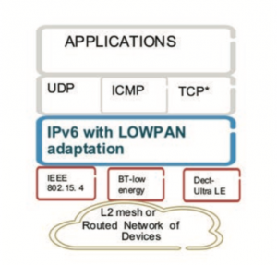
From 6LoWPAN to 6Lo
The 6lo stack is also under consideration for the Wifi Alliance’s HaLoW standard (low-power operation in 900 MHz band), on IEEE 802.11ah and Low-Power Wide Area Networks. The following figure presents the 6lo stack.

Slide 32
From 6LoWPAN to 6Lo
The 6LoWPAN or the 6lo stack could be a unifying standard for running IP protocols over the multitude of Internet-of-Things (IoT) L2 technologies that today require many application gateways to convert packets to IP networks connecting to data centers or other IoT networks.
The 6lo stack supports UDP with compression and RFC 7400 defines generic header-compression mechanisms for further applicability in the constrained node networks.
The output and concept of the 6lo WG, in some cases, may be applicable in non-6LoWPAN node networks where energy preservation and stateless header compressions are critical.

